Slide 1
Dynamics & Control 3 CONTROL
Section:
Exercises
Dr. Olaoluwa Popoola
Email: Olaoluwa.popoola@glasgow.ac.uk

Slide 2
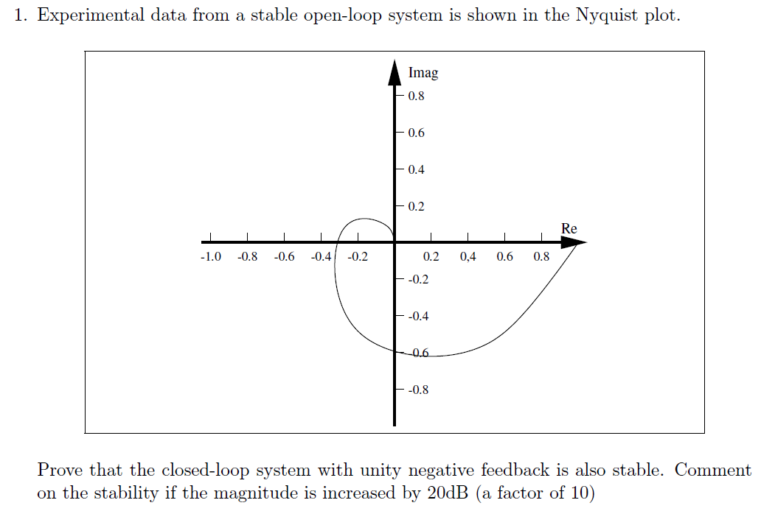
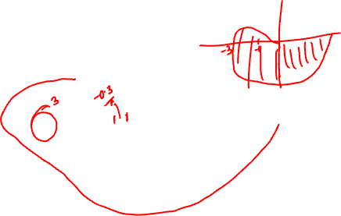
Worked example 1

Slide 3
Worked example 1
Solutions: The locus does not encircle the critical point, -1, as it crosses the negative real axis at -0.3. Therefore, the closed-loop system is stable.
If the magnitude is increased by 20dB (which is 10 in linear), the crossing point changes from -0.3 to -3. This time the locus will encircle the critical point -1 and the closed-loop system is now unstable.

Slide 4
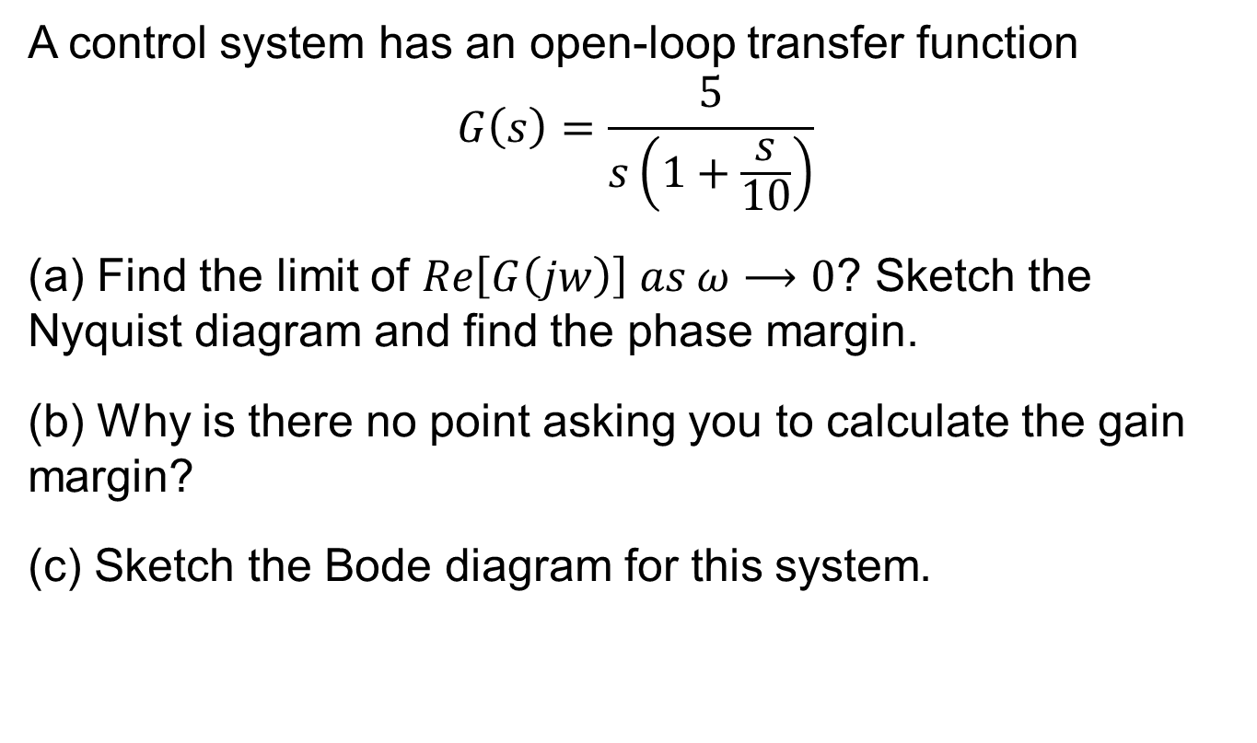
Worked example 2
A control system has an open-loop transfer function
$$G\left(s\right)=\frac{5}{s\left(1+\frac{s}{10}\right)}$$
(a) Find the limit of $Re\left[G\left(jw\right)\right] as ω⟶0$? Sketch the Nyquist diagram and find the phase margin.
(b) Why is there no point asking you to calculate the gain margin?
(c) Sketch the Bode diagram for this system.

Slide 5
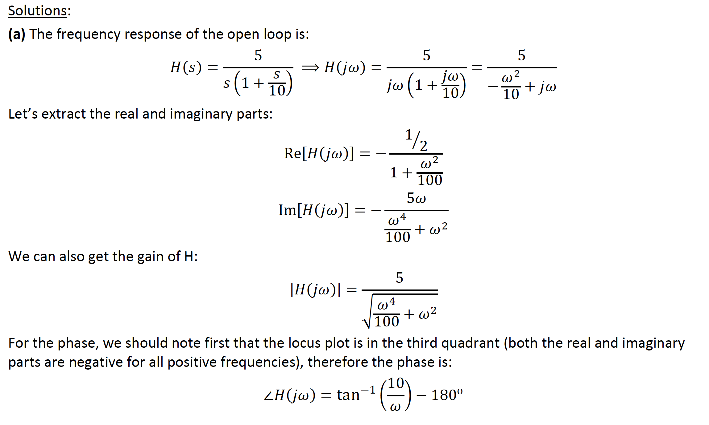
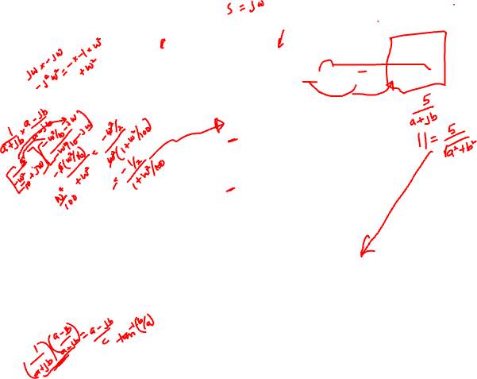

Slide 6
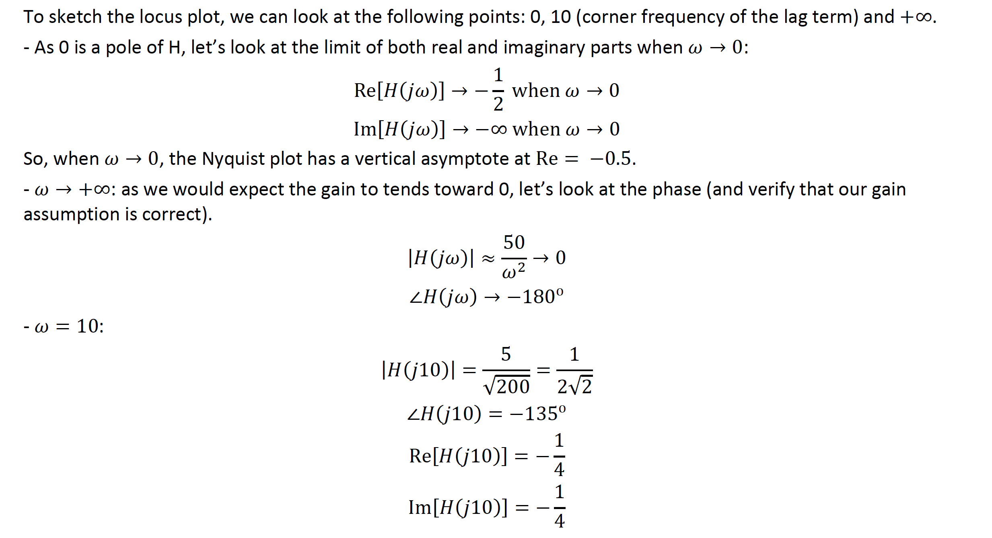
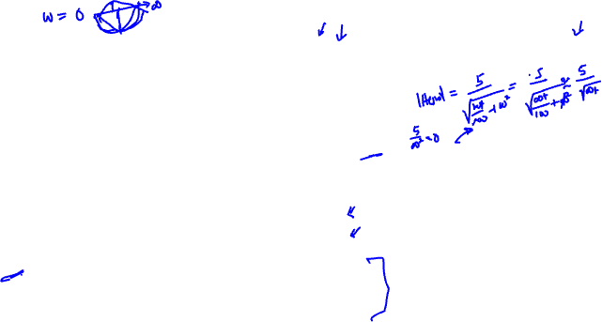

Slide 7
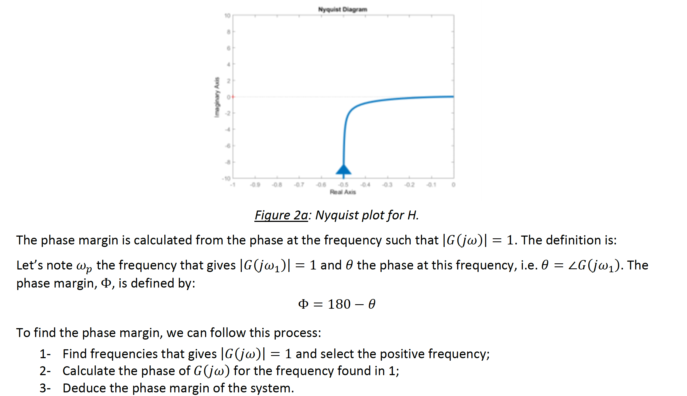

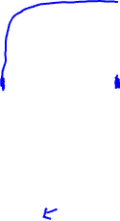

Slide 8
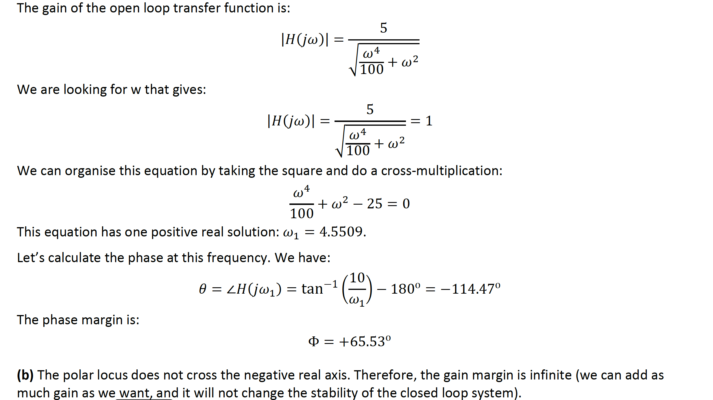
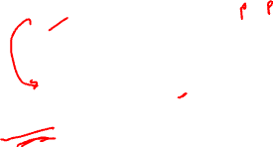
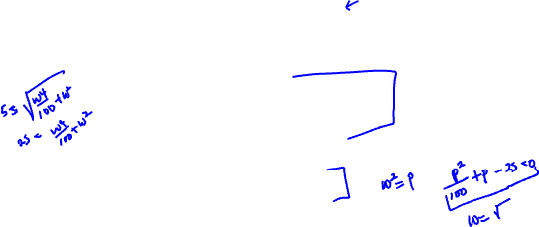

Slide 9
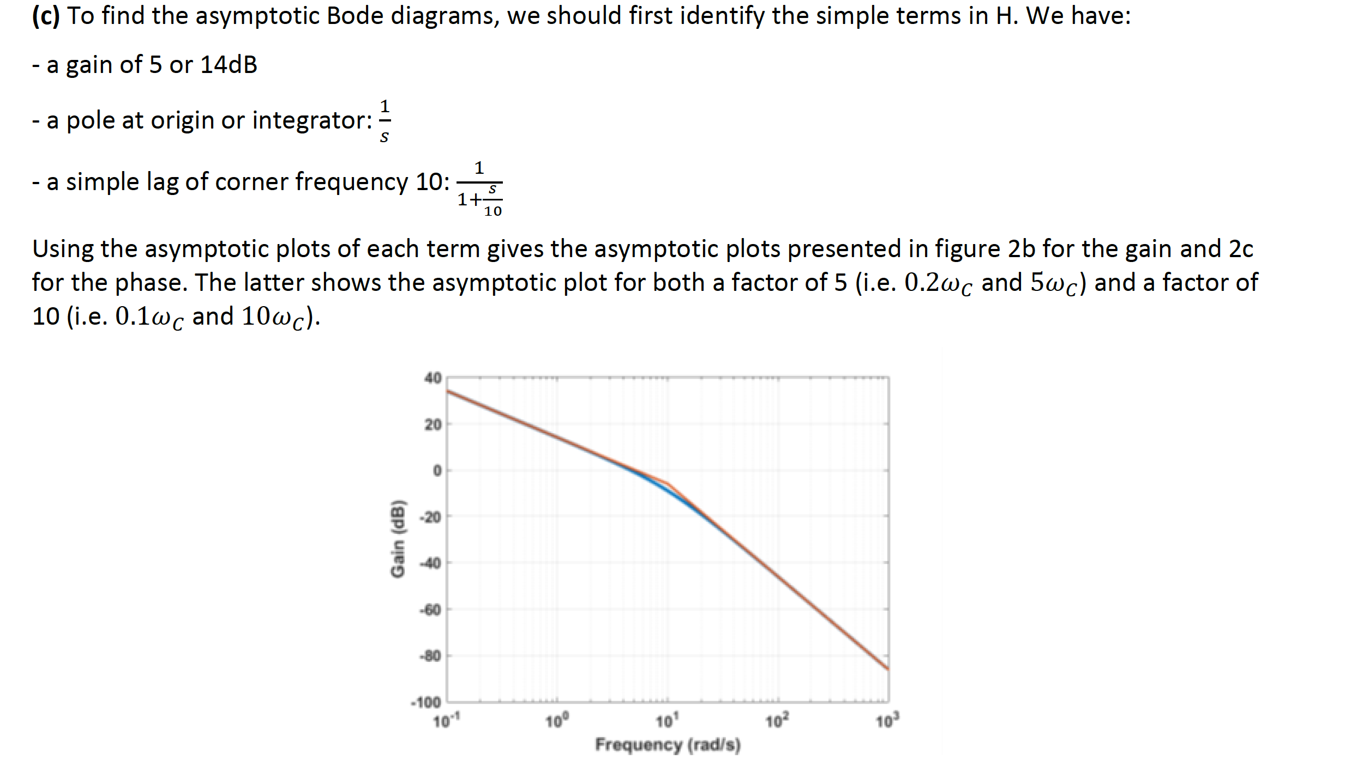
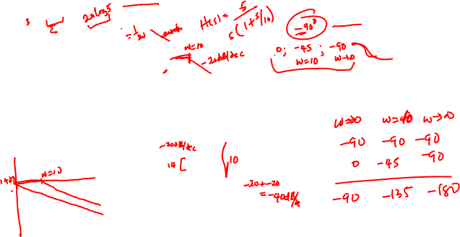

Slide 10
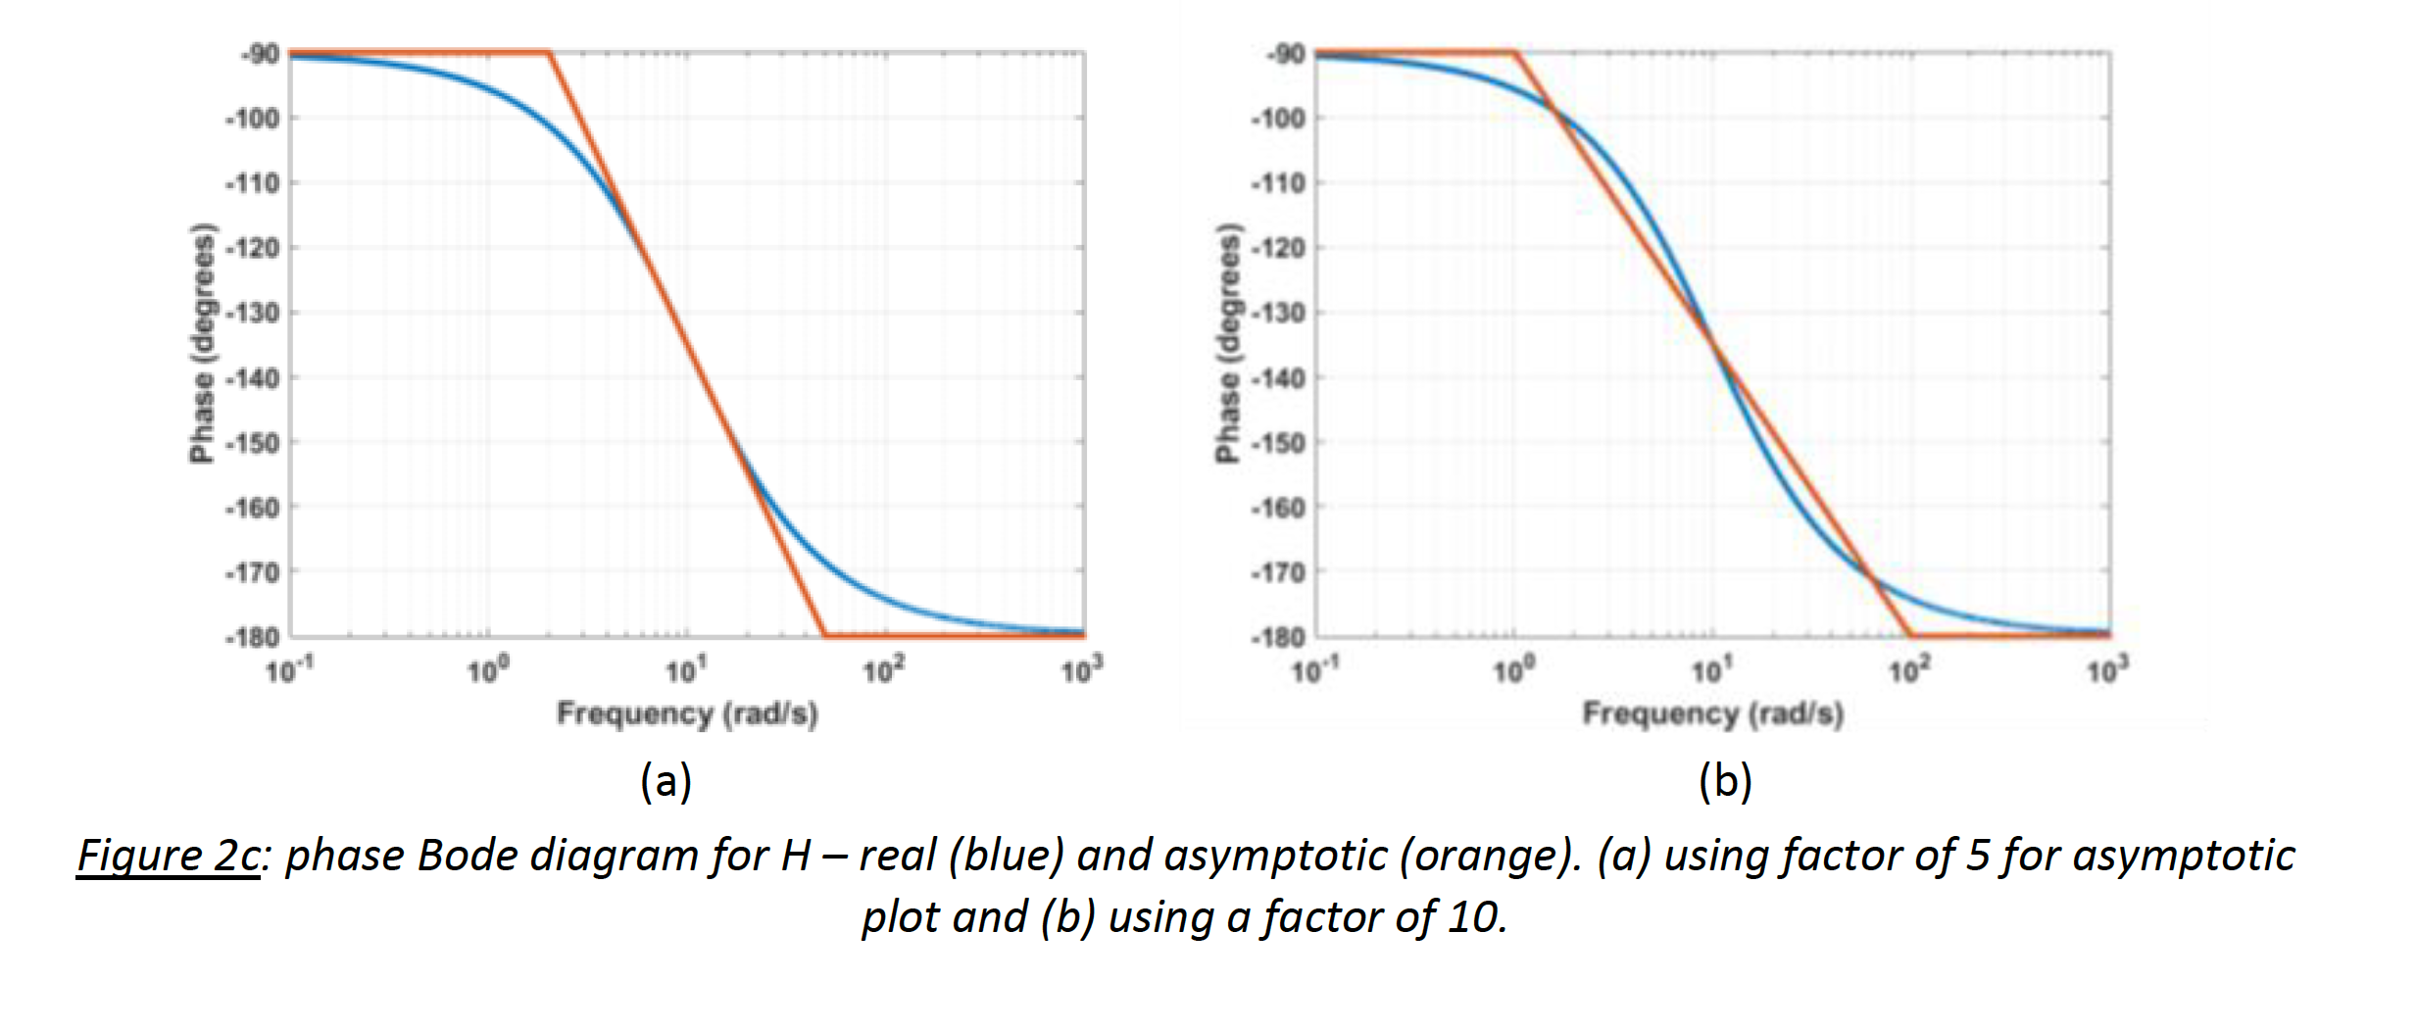
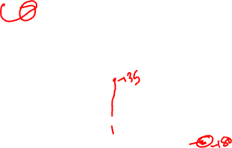

Slide 11
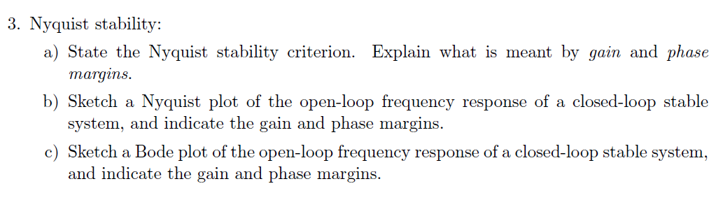
Worked example 3

Slide 12
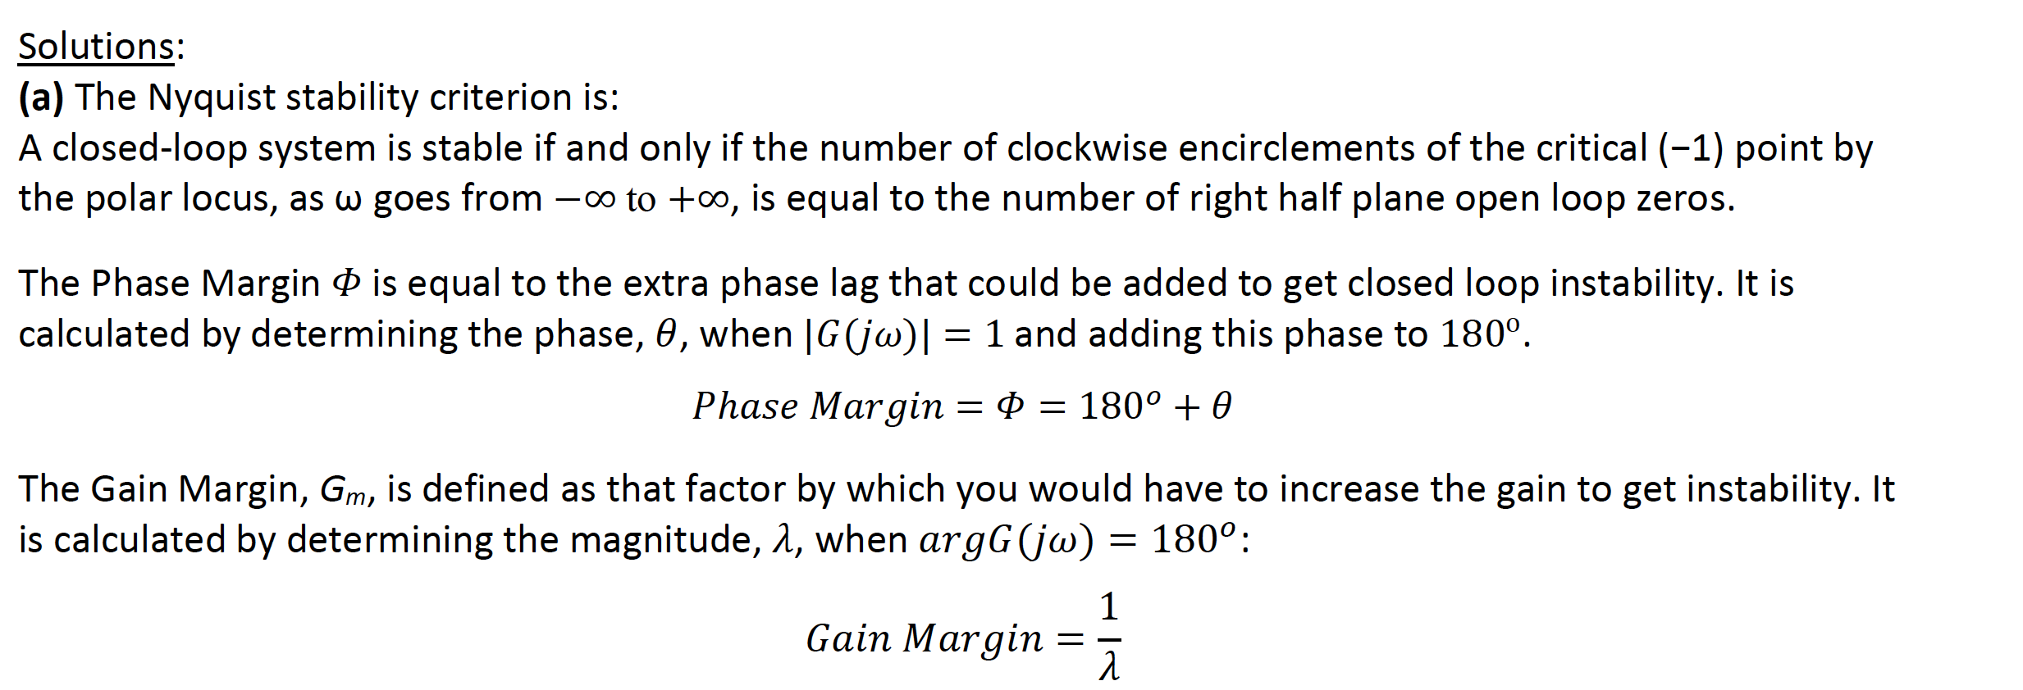
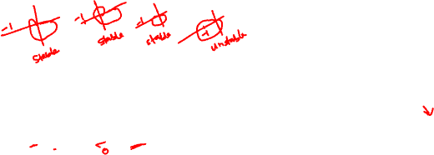

Slide 13
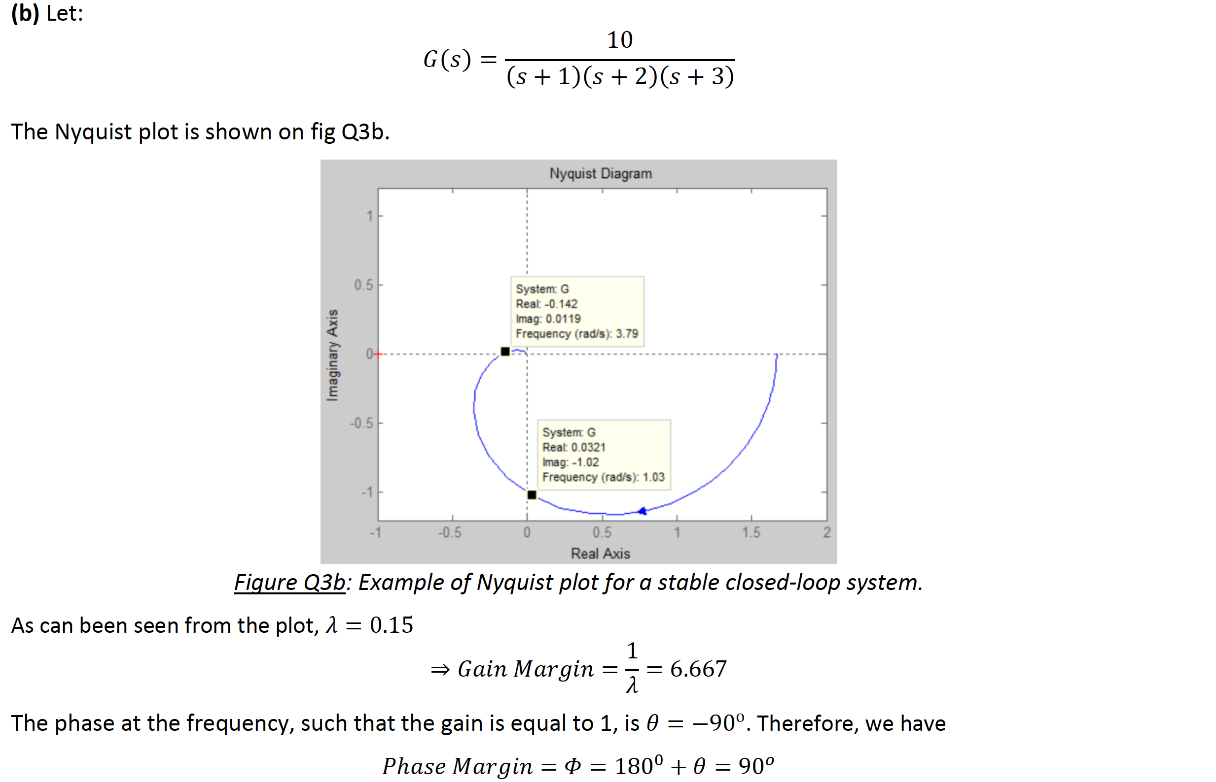
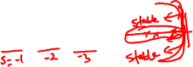

Slide 14
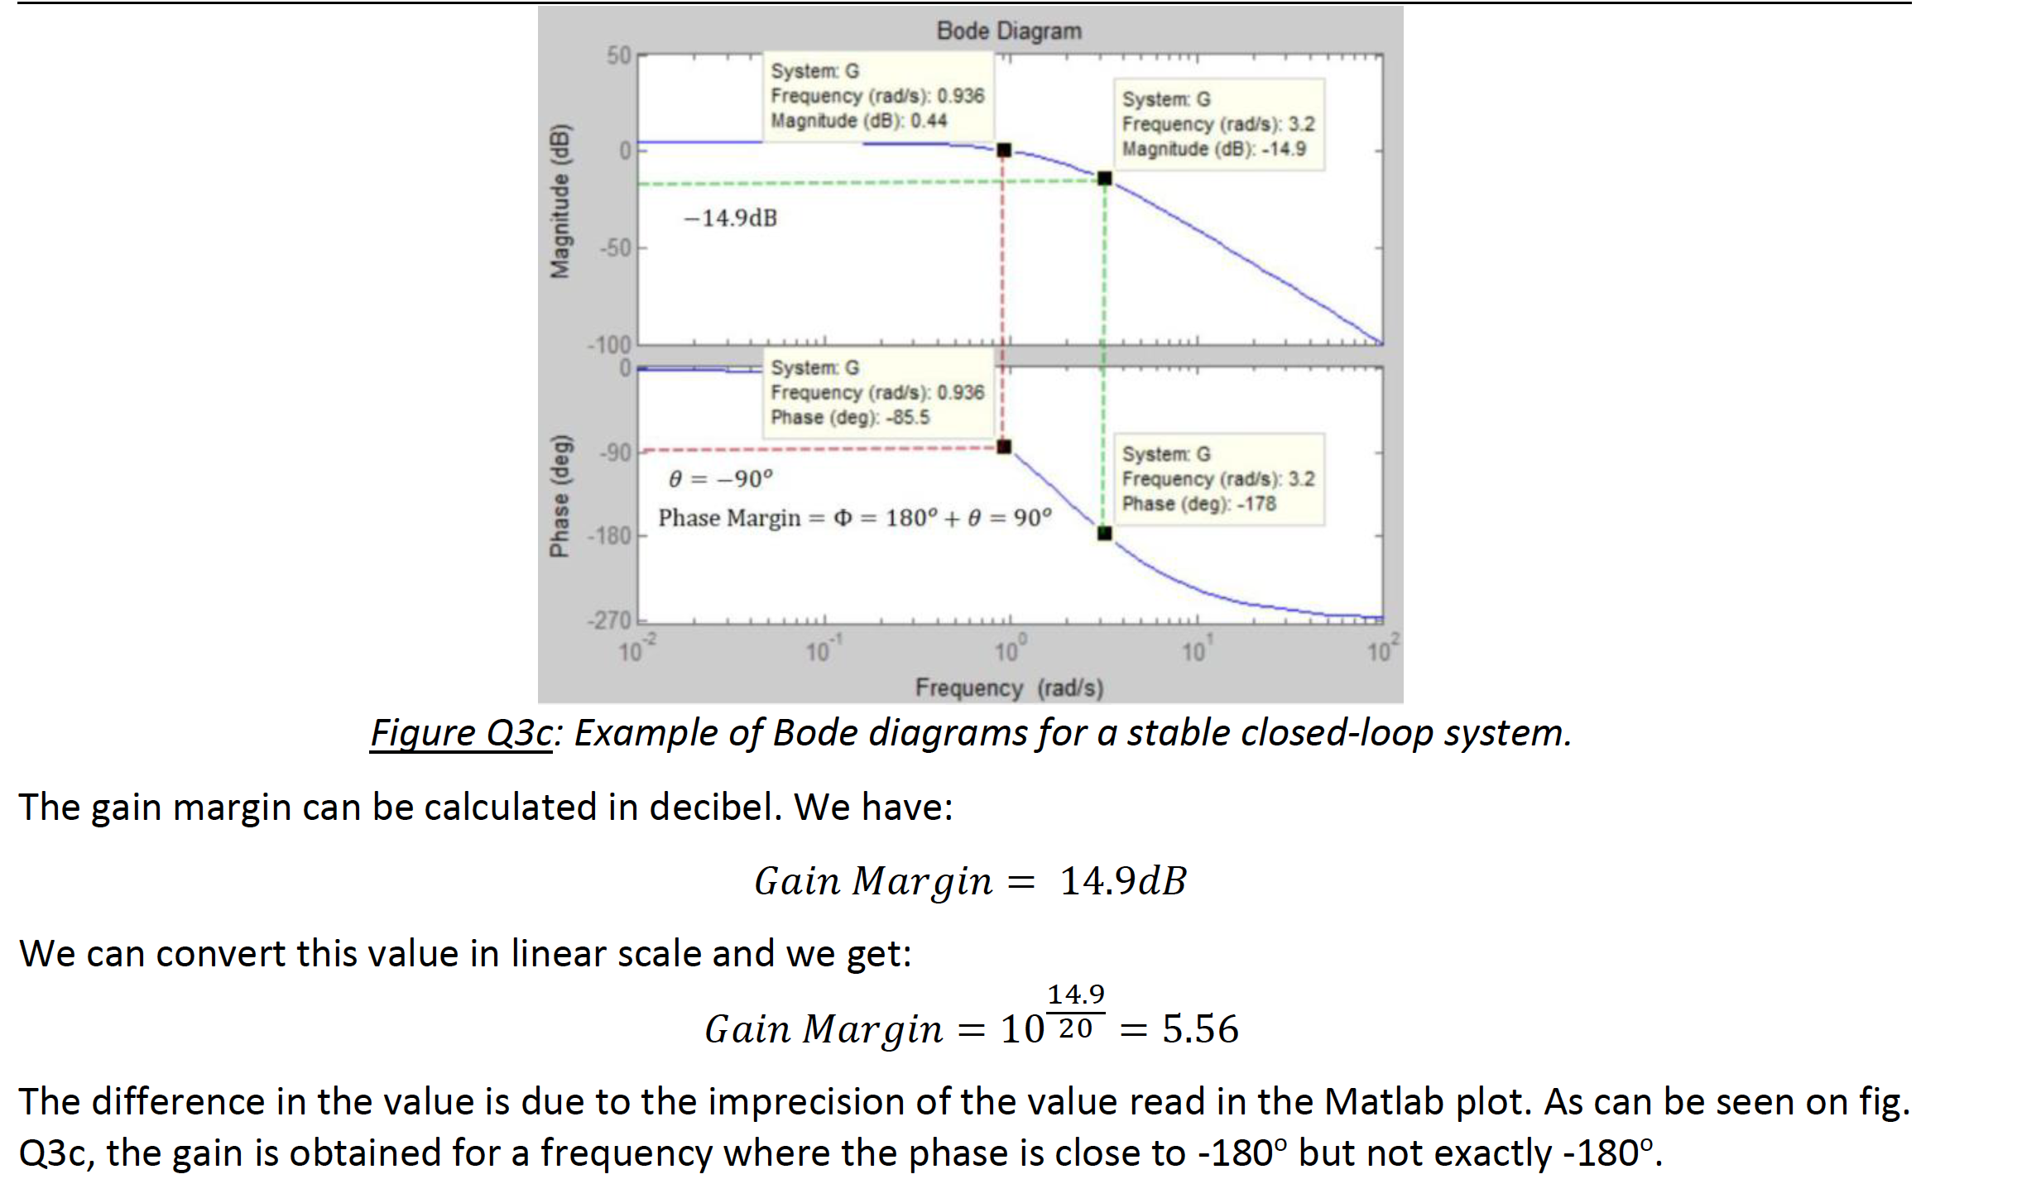
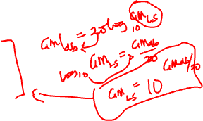
(c) Let consider the same transfer function as in (b). Its Bode diagrams are below:

Slide 15
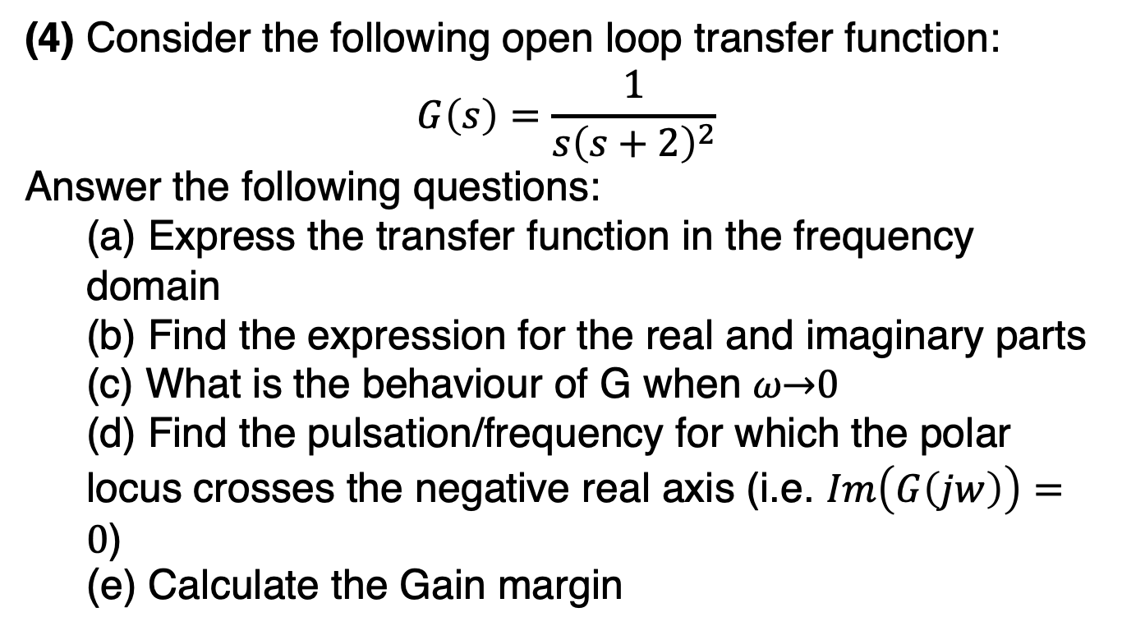
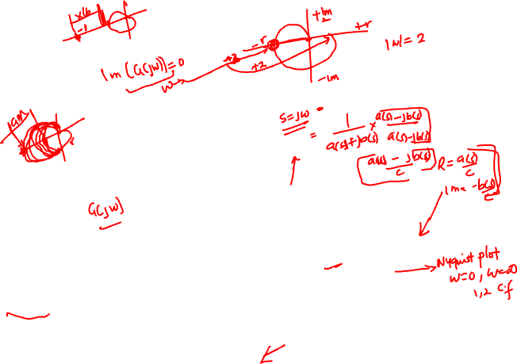
Worked example 4
(4) Consider the following open loop transfer function:
$$G\left(s\right)=\frac{1}{s{\left(s+2\right)}^{2}}$$
Answer the following questions:
(a) Express the transfer function in the frequency domain
(b) Find the expression for the real and imaginary parts
(c) What is the behaviour of G when 𝜔→0
(d) Find the pulsation/frequency for which the polar locus crosses the negative real axis (i.e. $Im\left(G\left(jw\right)\right)=0$)
(e) Calculate the Gain margin

Slide 16
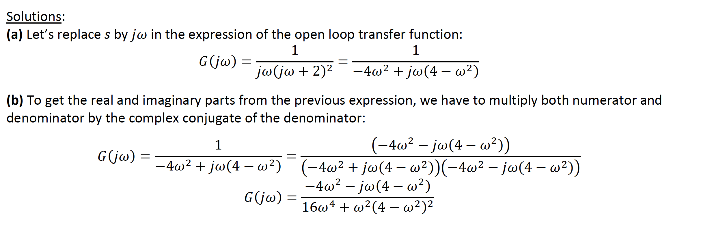
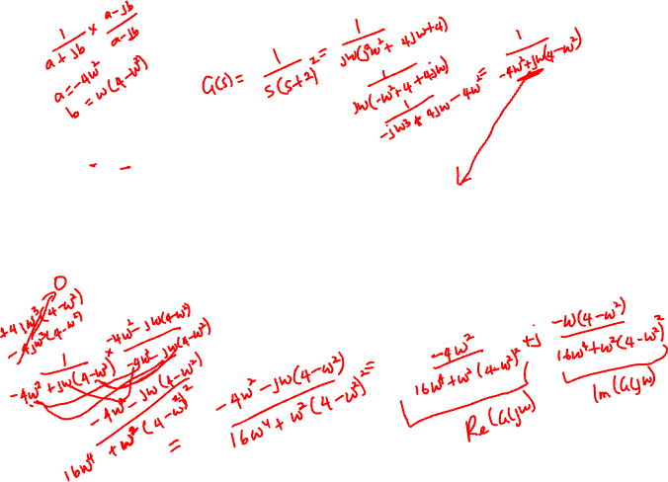

Slide 17
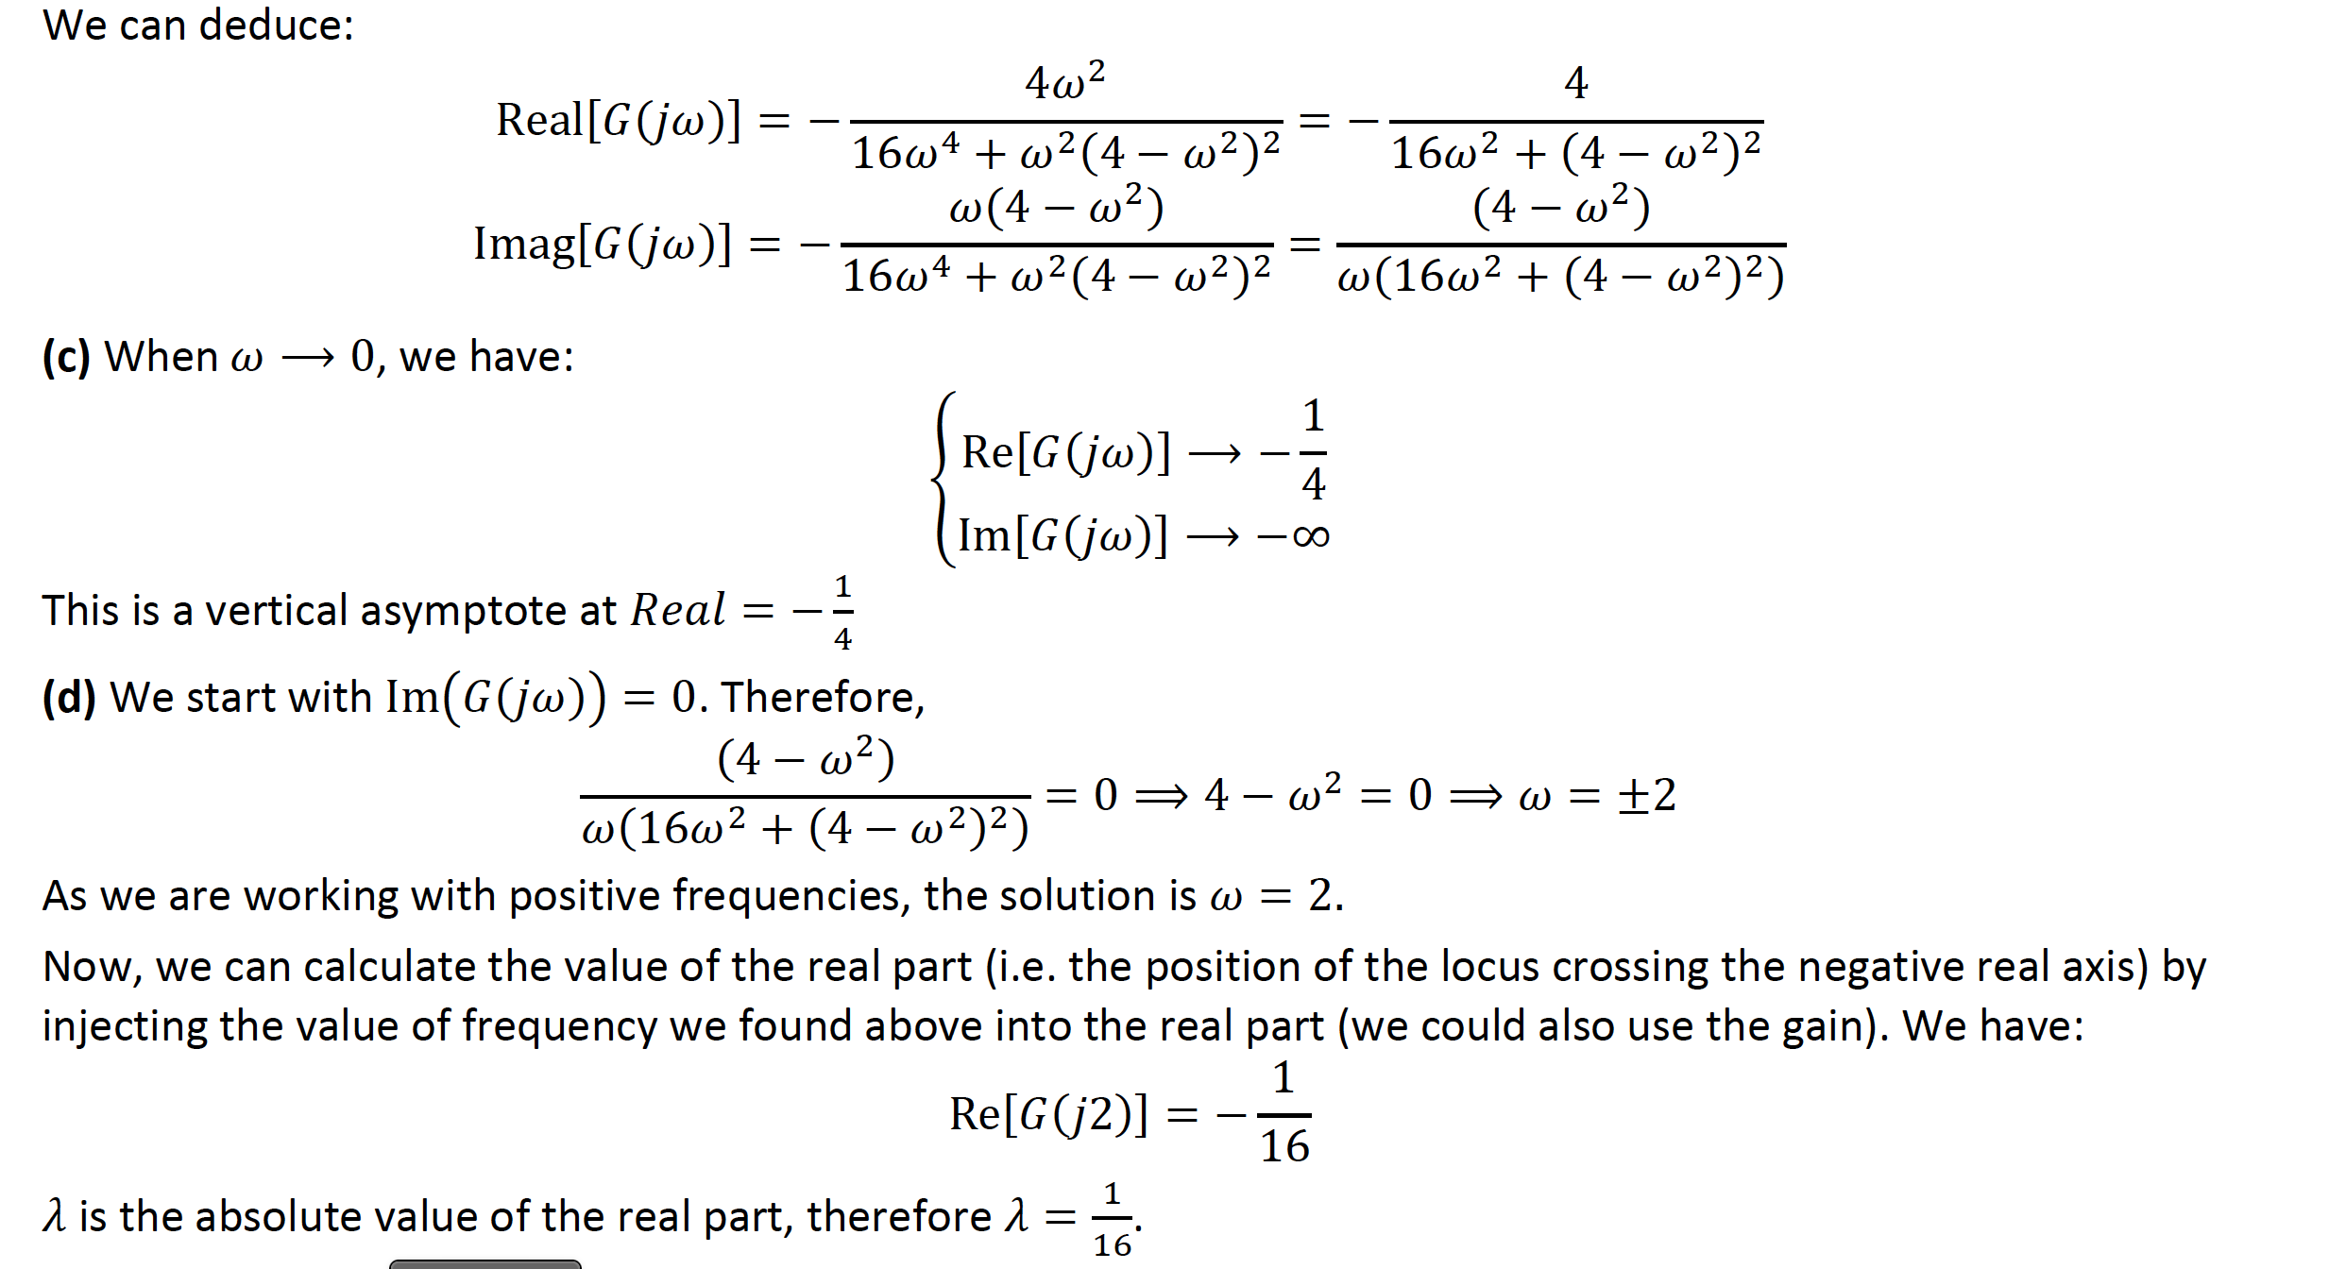
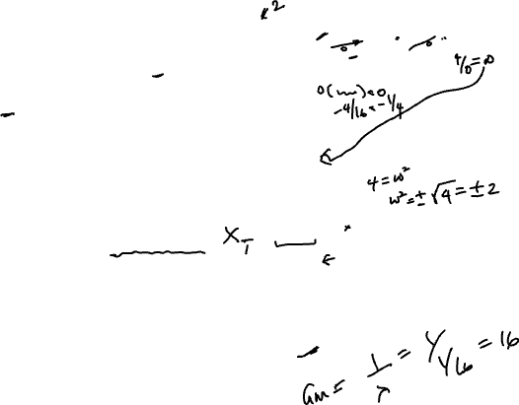

Slide 18
(e) The gain margin is the inverse of 𝜆: 𝐺𝑎𝑖𝑛 𝑀𝑎𝑟𝑔𝑖𝑛=1/𝜆 =16

Slide 19
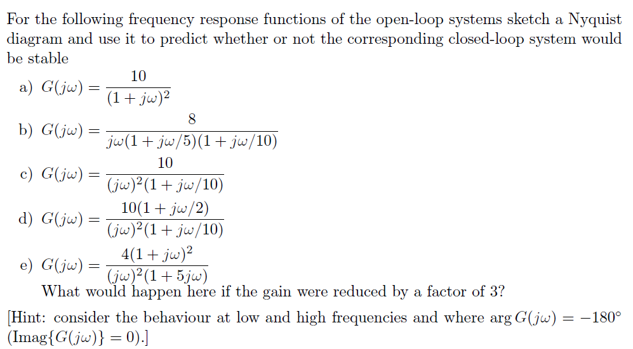
Worked example 5

Slide 20
A general method (that may sometimes need to be adapted to specific cases) is:
1- Find the frequency response of the open loop by substituting s by j𝜔;
2- Express the real/imaginary parts and the gain/phase;
3- Find the point for 𝜔=0 or 𝜔⟶0, if 0 is a pole of the transfer function;
4- Find the limit of the Nyquist locus when 𝜔⟶+∞;
5- Find the point on the Nyquist locus for each corner frequencies in the transfer function.

Slide 21
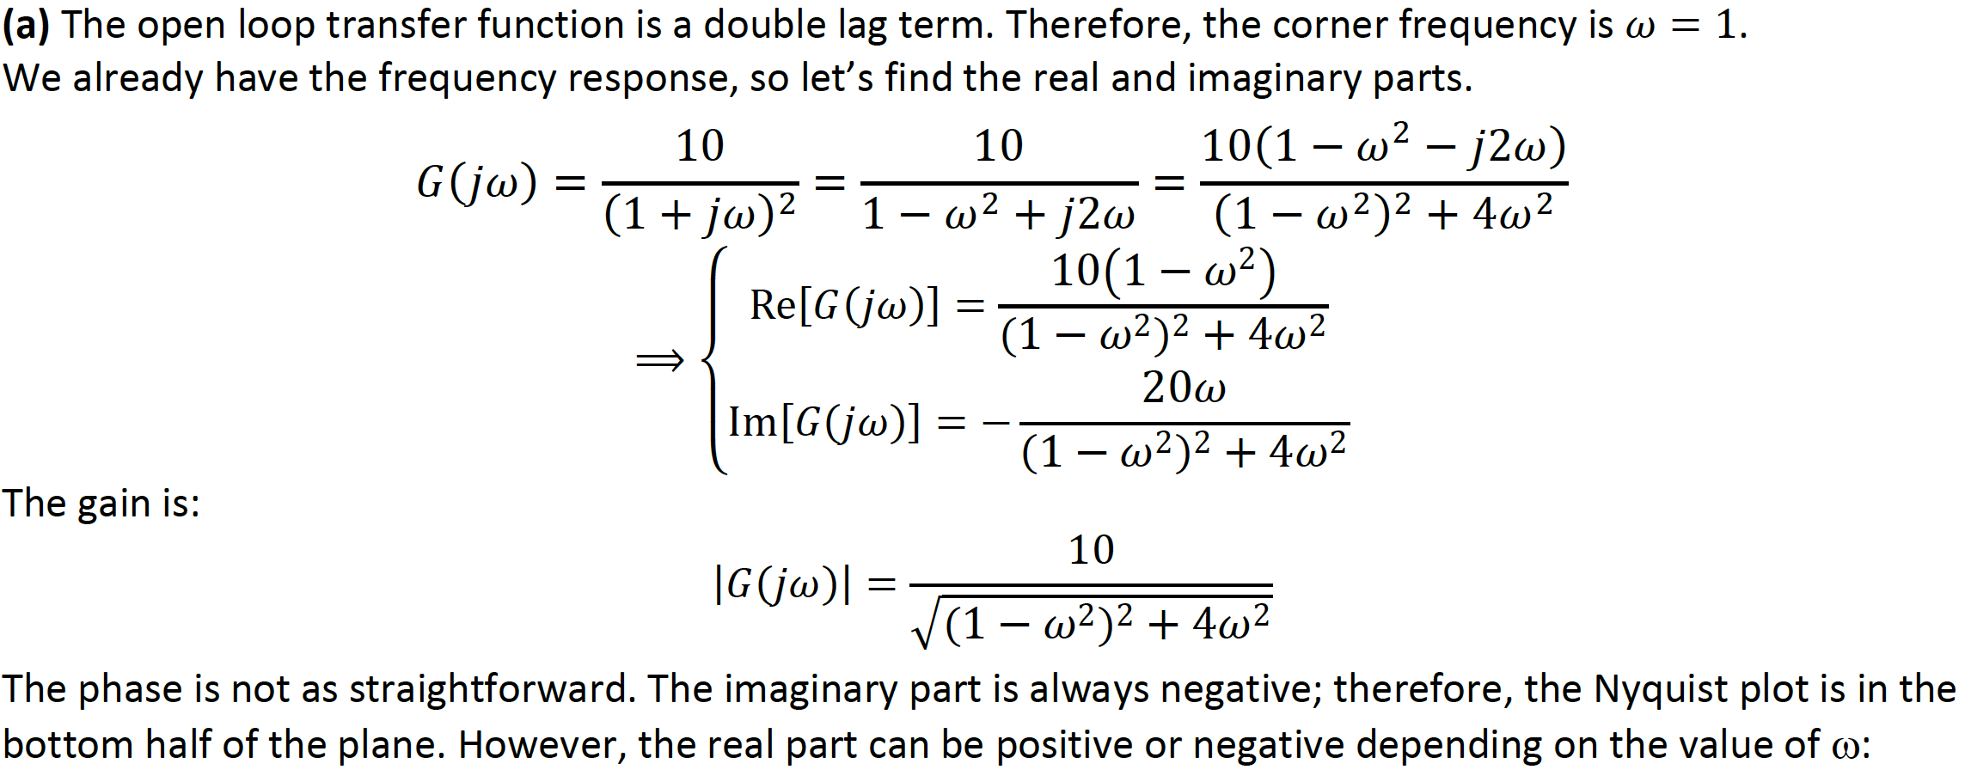
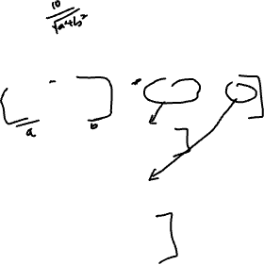

Slide 22
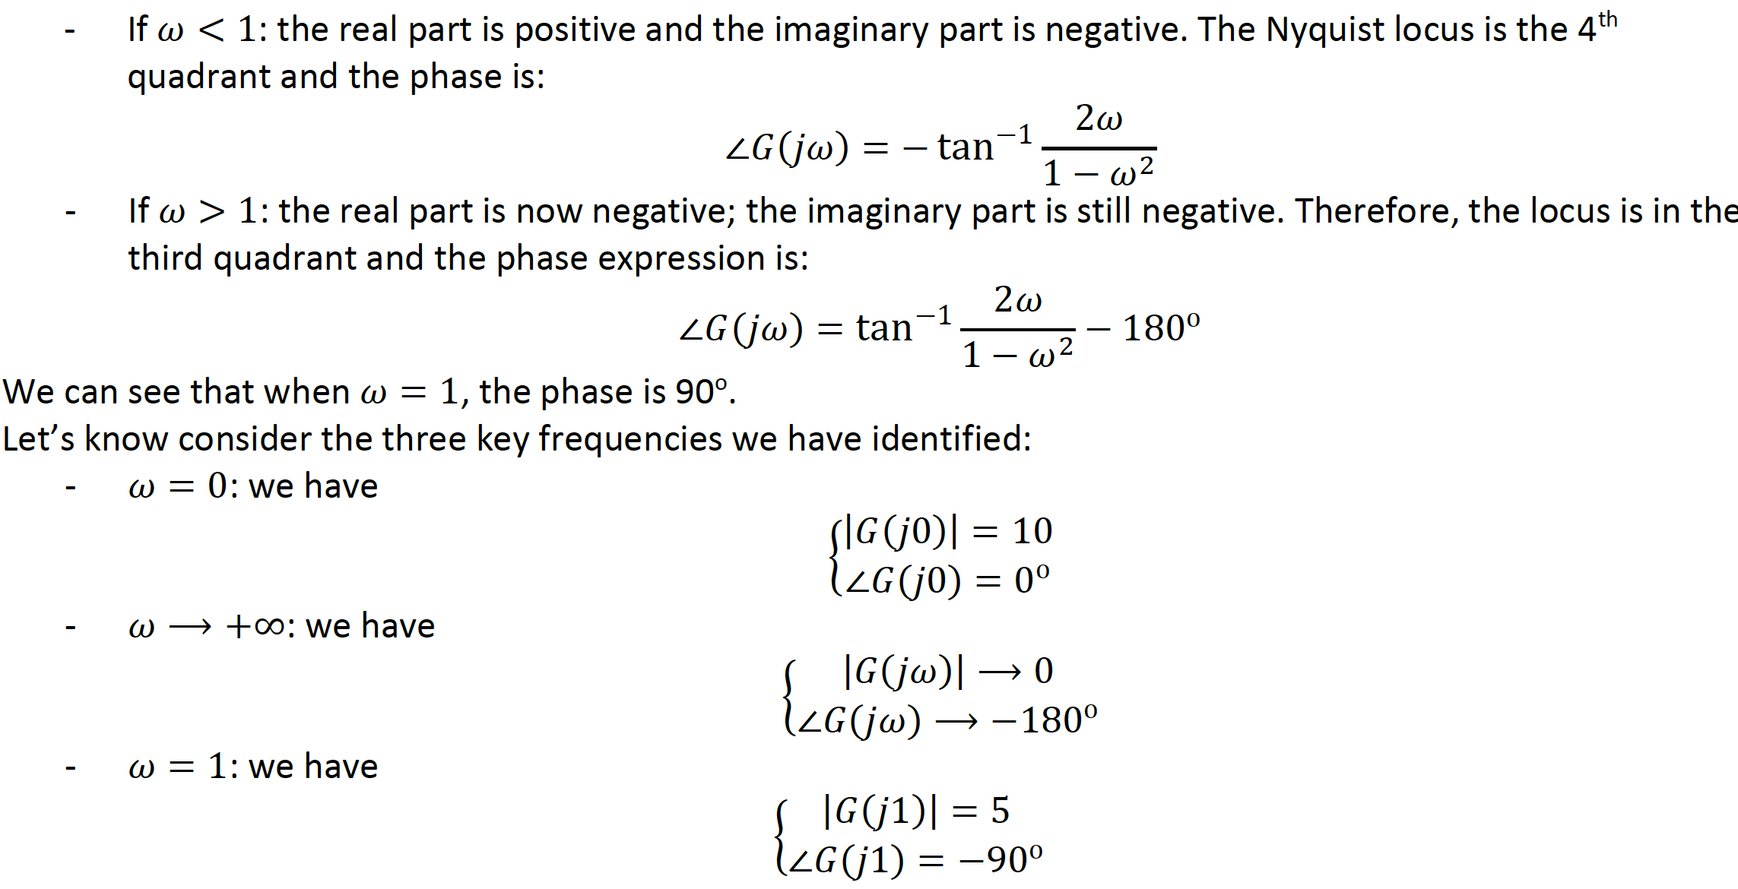
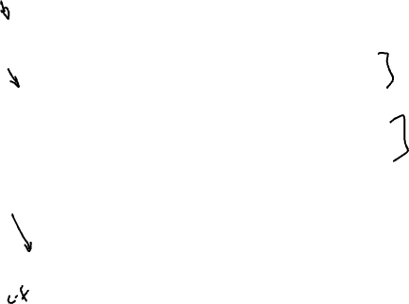

Slide 23
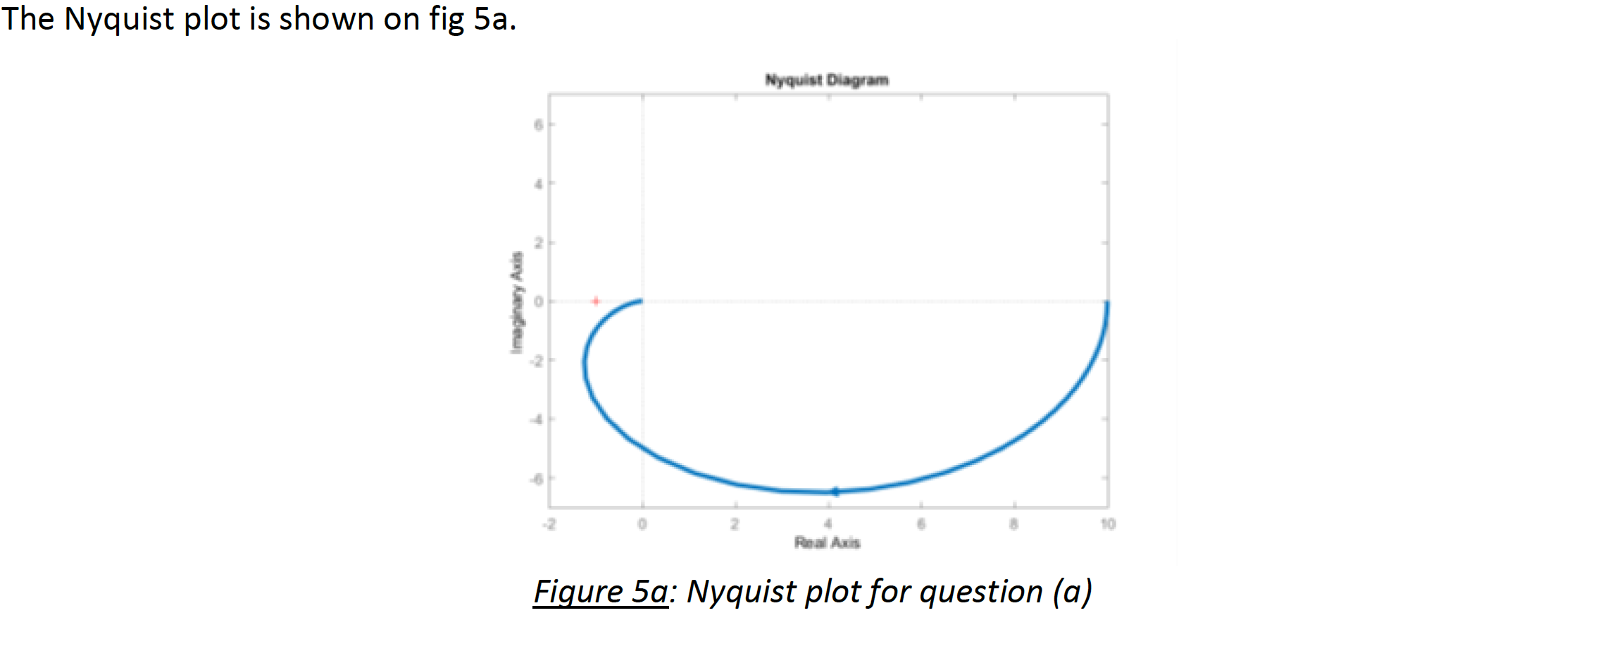
The Nyquist plot does not encircle the -1 point so the system is stable

Slide 24
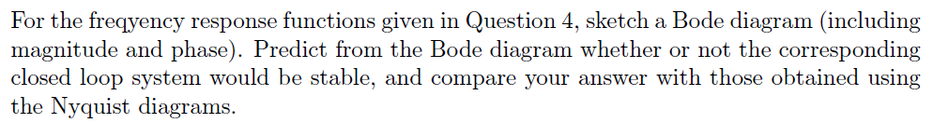
Worked example 6

Slide 25
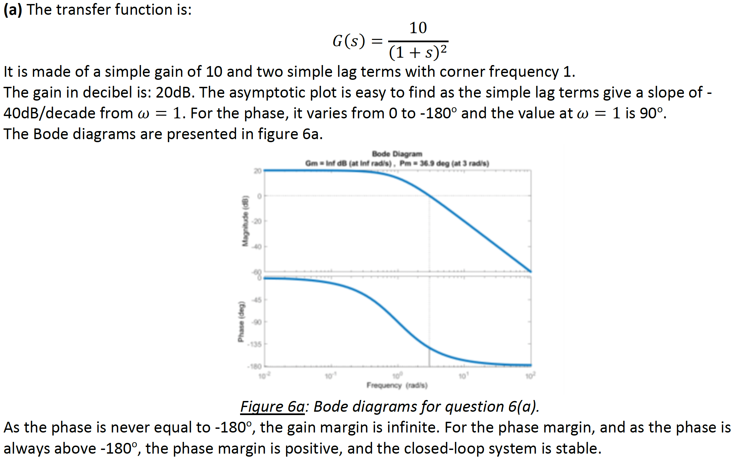
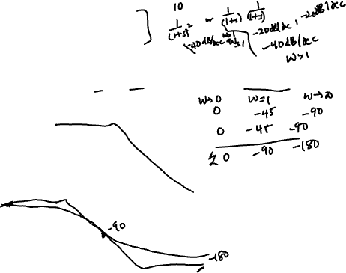

Slide 26
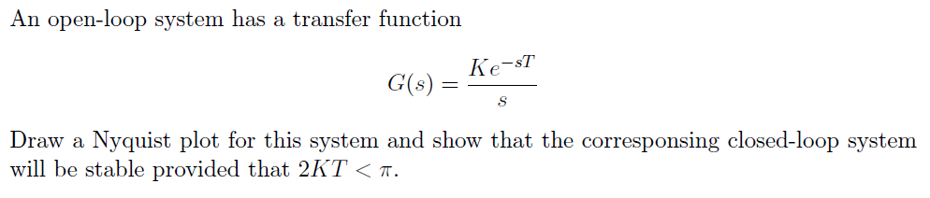
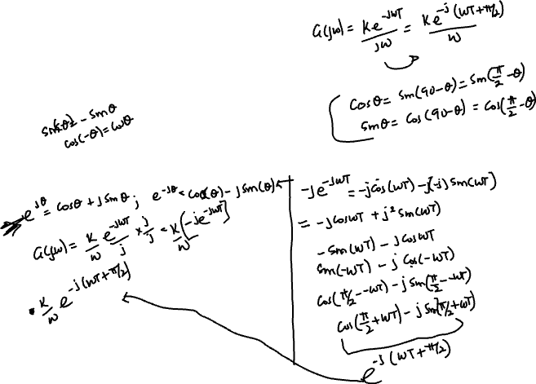
Worked example 7

Slide 27
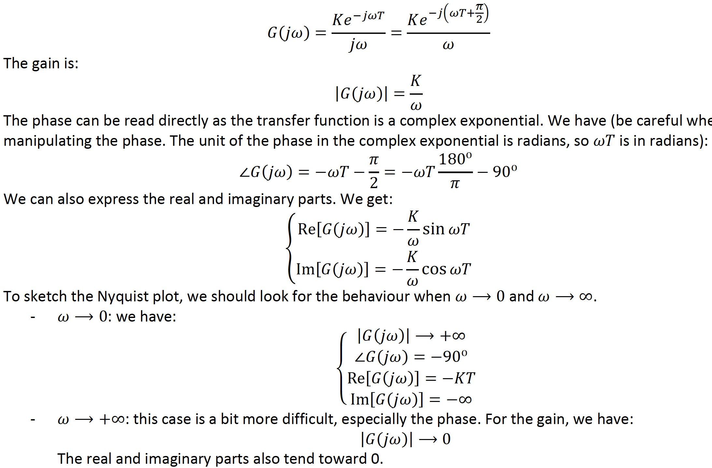
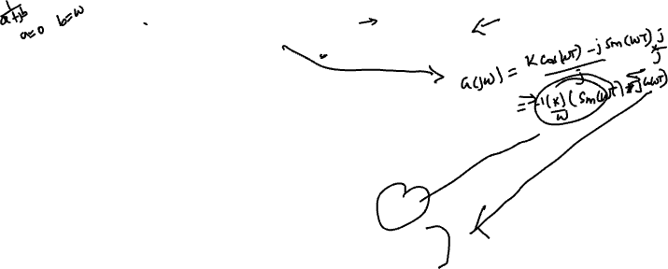

Slide 28
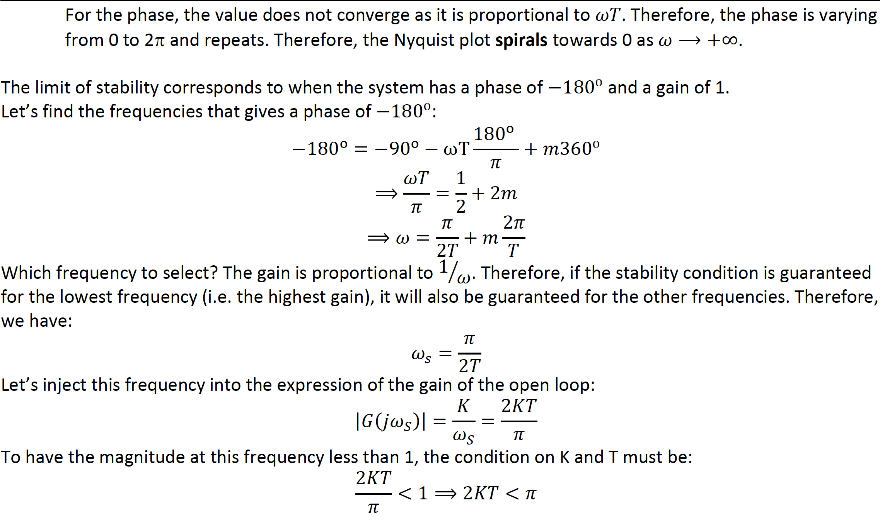

Slide 29
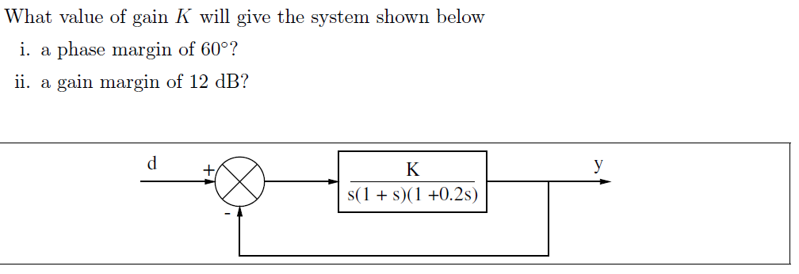
Worked example 7

Slide 30
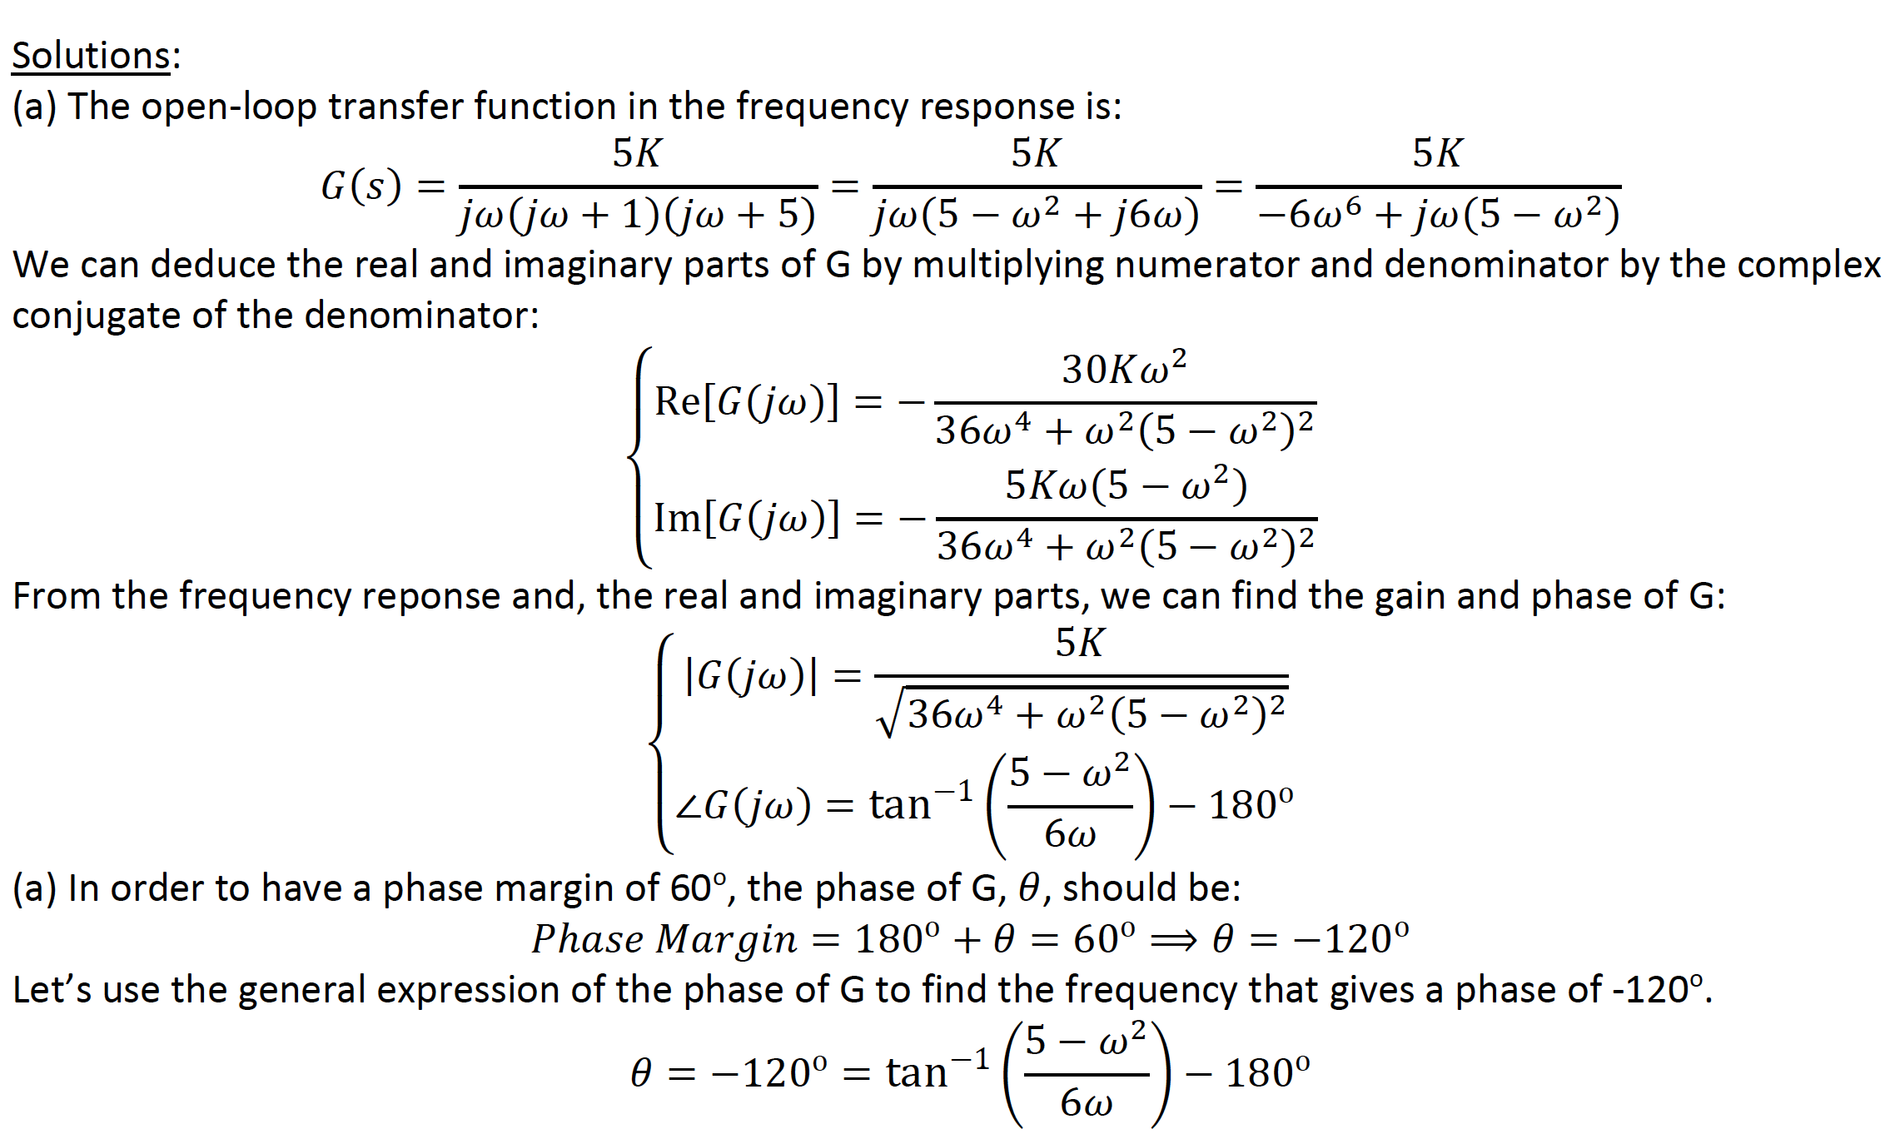

Slide 31
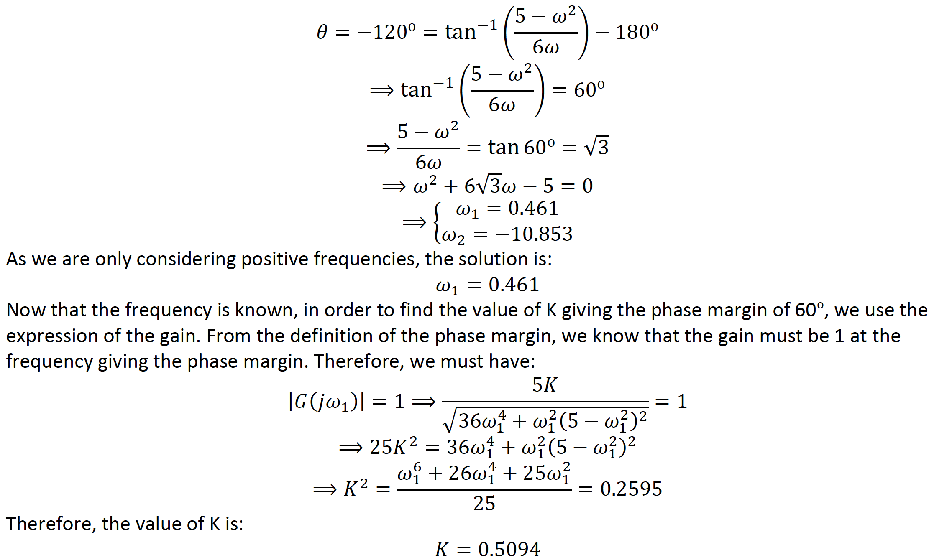

Slide 32
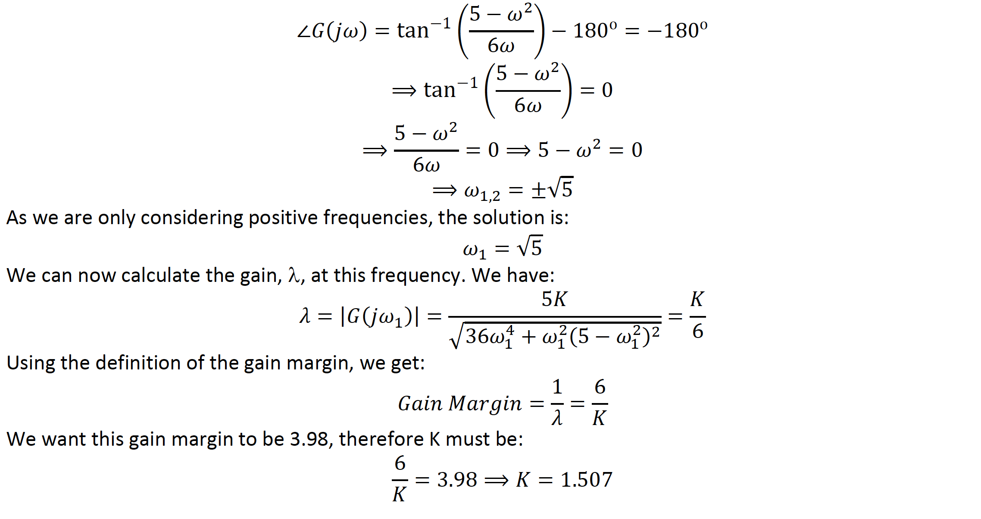
(b) In this question, we are looking for the value of K that gives a gain margin of 12dB, or 3.98 in linear gain. The gain margin is defined as the inverse of the gain when the phase is -180deg. Therefore, the first step is to find the frequency that gives a phase of -180deg.
We have:

